Slide 1
IE 362 Lecture 14: Social Network Analysis
Il-Chul Moon
Department of Industrial and Systems Engineering
KAIST

Slide 2
Short recap

Slide 3

What is a social network?
Relations among people
Nodes are people, and links are relations.
Difference between network and graph
Graph: binary matrix
Network: weighted matrix

Slide 4
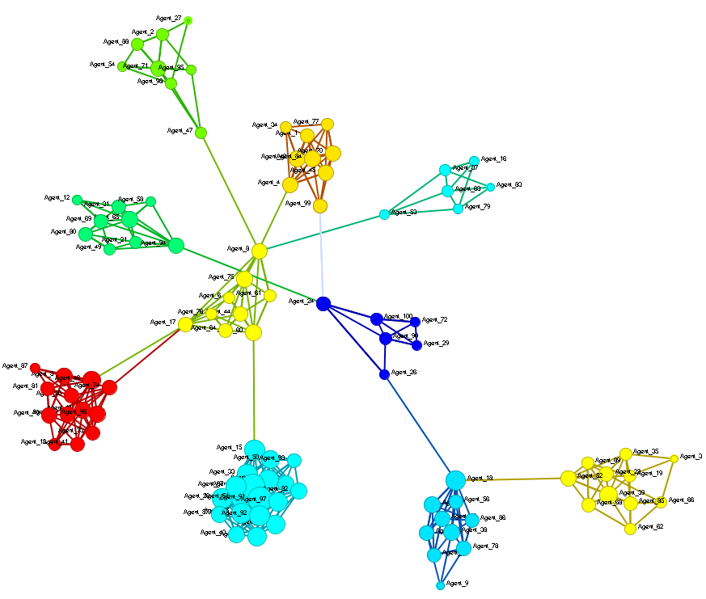
Key Techniques in Social Network Analysis
So, they started to see social networks as social structures.
Then, how to find the leaders, the organizations, and the system?
Measures
Required by sociologists looking for a key personnel
Clusters
Required by sociologists
looking for a sub-group
Dynamics
Triadic closure and strength of weak ties

Slide 5

Centralities: Degree Centrality
Simple! Counting the number of links
Local measure
Do not need the network-wise calculation
Approximate hubs in a network
I have four links.

Slide 6
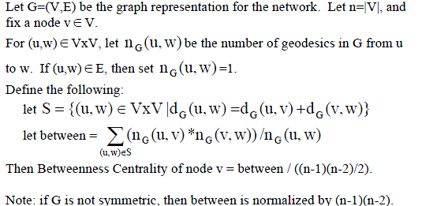
Centralities: Betweenness Centrality
Simple! Counting the number of all-pair shortest paths going through the node
Global measure
Need the whole network structure to calculate a value for a node
Interesting implications
Has been suggested as a information/influence transfer indicator
Ten shortest paths among APSPs go through me.

Slide 7
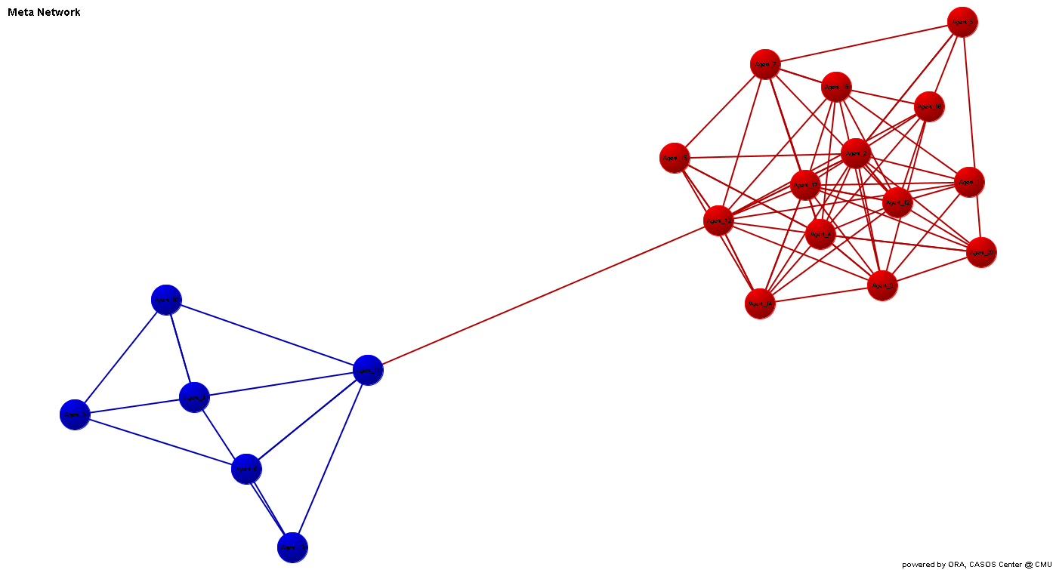
Newman Clustering
Girvan-Newman Algorithm (Girvan and Newman, 2002)
The betweenness of all existing edges in the network is calculated first.
The edge with the highest betweenness is removed.
The betweenness of all edges affected by the removal is recalculated.
Steps 2 and 3 are repeated until no edges remain.
Pretty nice tool to find a cohesive group
Highest Edge Betweenness

Slide 8
Newman Clustering
2
5
1
4
3
6
Finding Shortest Path
V = the set of vertexes
W = the set of weights on edges
K = number of clusters
Newman Clustering(V, W, K)
While True:
betweenness = calculateEdgeBetweenness(V,W)
edgeWithMaxBetweenness = findMaxBetweennessEdge (W,betweenness)
W.removeEdge (edgeWithMaxBetweenness)
components = findComponents(V,W)
If |components| == K
break
1→2 : 1-2
1→3 : 1-3
1→4 : 1-3-4
1→5 : 1-3-4-5
1→6 : 1-3-4-6
2→1 : 2-1
………………………..
5→6 : 5-6
6→1 : 6-4-3-1
6→2 : 6-4-3-2
6→3 : 6-4-3
6→4 : 6-4
6→5 : 6-5
Finding Max Edge Betweenness
3←→4
Remove Max Edge
2
5
1
4
3
6

Slide 9
Offline class plan

Slide 10
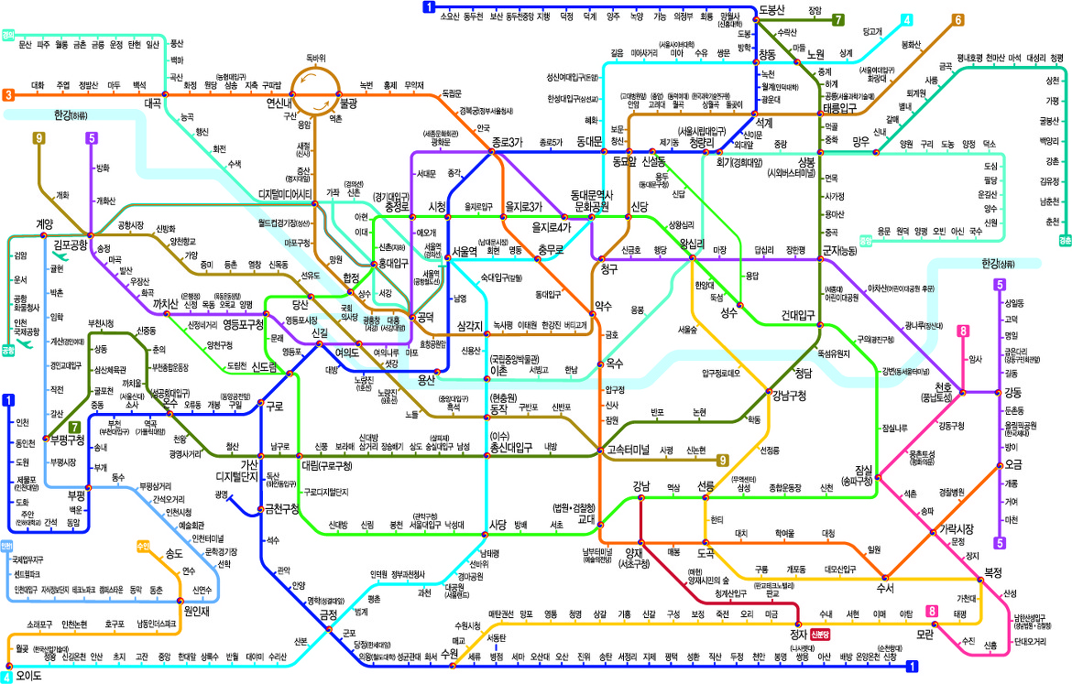
Subway Network
Seoul has the best subway station network.

Slide 11
To-Do: Newman Clustering
Complete ‘Dijkstra.py’ and ‘NetworkClustering.py’
Read ‘Dijkstra.py’, ‘Graph.py’, and ‘NetworkClustering.py’
To-Do 1: Complete ‘performAllDestinationDijkstra’ in ‘Dijkstra.py’
Complete the return of routes from a single source to all destinations
To-Do 2: Complete ‘calculateEdgeBetweenness’ in ‘NetworkClustering.py’
Use the previously returned “route” to count the edge betweenness
To-Do 3: Complete ‘performNewmanClustering’ in ‘NetworkClustering.py’
Which method to use for computing the edge-betweenness?
Find the maximum edge-betweenness?
After finding the max edge, what should you perform?

Slide 12
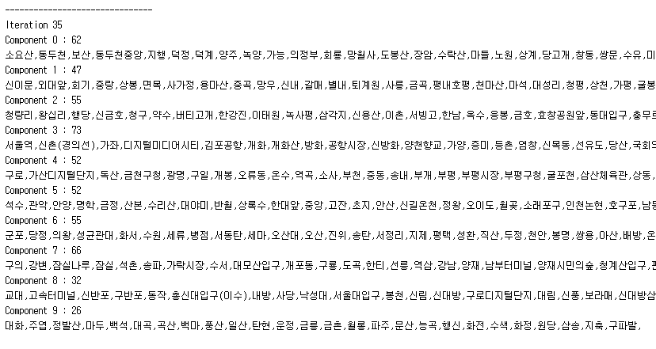
Expected Result
Execute ‘NetworkClustering.py’
Small Dataset : Subway-Seoul-ver-2.csv
Full Dataset : Subway-Seoul.csv
Change the K value to experiment the number of clusters

